Slide 1
Computation of Enterprise Value using Enterprise DCF
Dr. Sarveshwar Kumar Inani
(Ph.D., IIM Lucknow)

Slide 2
Agenda:
Determine the value of operations
Computation of Enterprise Value
Value of Equity
Value under Multiple Scenarios

Slide 3
Enterprise DCF: Introduction
Traditionally, Book value approach and relative valuations were popular. However, these days Discounted Cash Flow (DCF) is most popular. All these methods are used in the industry to derive corporate valuation.
DCF method is superior due to number crunching and endorsement by top consultancy firms like McKinsey.
DCF technique is identical to NPV method of capital budgeting. Only few difference are there:
Firm is a going concern (no finite life) vs a project has a finite life.
No salvage value in firm vs salvage value in project.
Many working capital and capital expenditure investments over the time in a firm vs only one cash outflow in a project.
So DCF computes the PV of all future free cash flows (forecasted) for an explicit forecast period of 5-15 years and after that terminal/continuing value.

Slide 4
DCF: Steps
Analyzing historical performance (all financial statements)
Forecasting performance (cash flows with growth)
Estimating the cost of capital (Debt, Equity)
Determining the terminal/continuing value
Calculating the firm value and interpret the results

Slide 5
Analyzing historical performance
Read and understand the income statement and balance sheet.
Past results are the basis for forecasting of future cash flows.
The purpose of preparation of financial statements is different from the purpose of valuation. Hence, accounting profits are adjusted to get free cash flows.

Slide 6
Analyzing historical performance: Steps
Compute Net Operating Profit Less Adjusted Taxes (NOPLAT, a term coined by McKinsey). Net Operating Profit After Taxes (NOPAT) is another term popular in valuation parlance. Both profitability measures focus on a business's core operations. NOPLAT includes changes in deferred taxes, while NOPAT does not. Deferred taxes arises due to separate books for accounting and tax purposes. If a company has no deferred taxes, then NOPAT and NOPLAT will be equal.
Compute free cash flow
Compute operating investments
Compute Return on Invested Capital (ROIC)

Slide 7
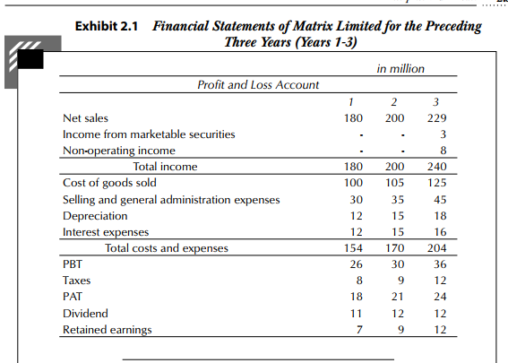
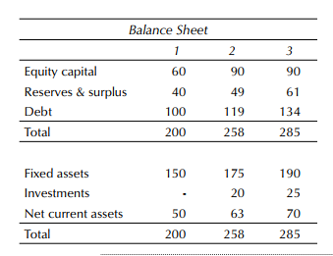
Example (Page 2.3, Book by Prasanna Chandra)
Read the Financial statements of Matrix Limited for 3 years.

Slide 8
Operating Invested Capital (OIC)
Separate Operating performance from non-operating performance (Income from marketable securities, non-operating income, interest expenses/finance cost).
Compute operating invested capital: identify assets involved in operations of business. It includes net fixed assets (Total value - depreciation) and net working capital (CA - non-interest-bearing CL) used in regular operations of business.
It is computed as total assets minus non-operating fixed assets (not used like surplus land, kind of investment) minus excess cash and marketable securities (if mentioned).
If we assume Investments in the balance sheet as excess investment (as given in the book), the operating invested capital will be 200, 238 (258-20), and 260 (285-25), for year 1, 2, and 3, respectively.

Slide 9
NOPLAT
NOPLAT=EBIT-Taxes on EBIT
While calculating EBIT, the following are excluded: interest expenses, interest/dividend income, and non-operating income (or loss).
Taxes on EBIT represents the taxes the firm would pay if it had no debt, excess marketable securities, or non-operating income (or loss). Taxes on EBIT can be calculated by adjusting the income tax provision for the income tax attributable to interest expense, interest and dividend income from excess marketable securities, and non-operating income (or loss).
Assume Marginal Tax Rate 40% and compute NOPLAT.

Slide 10
NOPLAT…Matrix Ltd.
 | Year 1 | Year 2 | Year 3
PBT Given | 26 | 30 | 36
Adjusment for:
Less: Income from Marketable Securities | - | - | -3
Less: Non-operating Income | - | - | -8
Add: Interest Expenses for debt | 12 | 15 | 16
EBIT | 38 | 45 | 41
Tax adjustments:
Tax provision given | 8 | 9 | 12
Add: Tax on Interest paid (income increased) | 4.8 | 6 | 6.4
Less: Tax on Income from Marketable Securities (income decreased) |  |  | -1.2
Less: Tax on Non-operating Income (income decreased) |  |  | -3.2
Adjusted tax on EBIT | 12.8 | 15 | 14
NOPLAT (EBIT-Adjusted Tax on EBIT) | 25.2 | 30 | 27

Slide 11
Return on Invested Capital (ROIC)
$$ROIC= \frac{NOPLAT}{Invested Capital}$$
Invested capital is usually measured at the beginning of the year or as the average at the beginning and end of the year. While calculating ROIC, define the numerator and denominator consistently. If an asset is included in invested capital, income related to it should be included in NOPLAT to achieve consistency. ROIC focuses on the true operating performance of the firm.
 | Year 1 | Year 2 | Year 3
NOPLAT | 25.2 | 30 | 27
Invested Capital at beginning of year | NA | 200 | 238
ROIC (based on bginning capital) | Cannot be computed | 15.00% | 11.34%
Invested Capital at end of year | 200 | 238 | 260
Average Capital | Cannot be computed | 219 | 249
ROIC (based on average capital) | Cannot be computed | 13.70% | 10.84%

Slide 12
Effective v/s Marginal Tax Rate
Effective tax rate is the overall tax rate a firm pay on total taxable income. It is computed as total taxes paid divided by total taxable income. It represents your average tax burden. For example, a firm earns $100,000 and pay $20,000 in taxes, effective tax rate is 20%.
Marginal tax rate is the tax rate applicable to the additional/marginal dollar of income earned based on the tax bracket a company’ income falls into. It is useful in determining the tax impact of additional income. Like 25% corporate tax in India.
Effective tax rate considers your entire income and tax deductions due to many reasons (SEZ etc.). Effective tax rate is typically lower than the marginal tax rate due to progressive tax structures and deductions.
Many firms follow different accounting standards for tax and for reporting purposes. For instance, firms typically use the straight-line method of depreciation for reporting purposes but the written down value method for tax purposes. This causes a discrepancy between reported income and taxable income.
Which Tax rate should be used? Generally, marginal tax rate is used as it is same for all years.

Slide 13
Free Cash Flow
The free cash flow (FCF) is the post-tax cash flow generated from the operations of the firm after providing for investments in net fixed assets and net current assets required for the operations of the firm.
FCF from operations = NOPLAT + Depreciation (non-cash item) - investment in current assets – investment in capital expenditures (fixed assets)
Free Cash flow has multiple definitions in industry. Refer this video (by Corporate Finance Institute YT) in class (Very insightful).

Slide 14
Free Cash Flow
 | Year 1 | Year 2 | Year 3
NOPLAT | 25.2 | 30 | 27
Add: Depreciation | 12 | 15 | 18
Less: Increase in working capital | 0 | 13 | 7
Less: Increase in Fixed Assets | 0 | 40 | 33
Free Cash Flow | Info not available | -8 | 5
Add: Post-tax non-operating income | 0 | 0 | 4.8
Free Cash Flow to Firm/Investors (Equity+lenders) | Info not available | -8 | 9.8

Slide 15
Free Cash Flow: Notes
1. Depreciation is a non-cash expense and added back.
2. Increase is working capital is considered cash outflow and decrease is considered cash inflow.
3. If fixed asset is purchases it is reduced, if sold added. You can prepare fixed assets account to get the net cash inflow/outflow from the capex.
4. Focus is on valuing the business from core and recurring operations of the business. Hence, Free cash flow will be used to compute valuation.
5. After adjustments of post-tax non-operating incomes and expenses (except financial expenses like interest), we get FREE CASH FLOW AVAILABLE TO ALL INVESTORS.
6. In this example, excess marketable investments are considered negative debt (kind of financing item). Hence, purchase of investments and interest on them are considered as financing activity.

Slide 16
General Guidelines for Historical Analysis
Consider 5-15 Years of past data (Stable period) of financial statements.
Understand the NOPLAT, ROIC, and revenue growth.
What are the reasons for growth?
Does the company/industry have tendency to return to mean over the time?
Was the growth fast? Is it sustainable in future for forecasting purpose?
Anything else which can help answer these questions.
We have learned:
NOPLAT
FCF
ROIC

Slide 17
Forecasting Performance (FCFs)
Dr. Sarveshwar Kumar Inani
(Ph.D., IIM Lucknow)

Slide 18
Agenda:
Forecasting Performance
Develop financial forecasts
Forecast the Profit and Loss Account
Forecast the Balance Sheet

Slide 19
Forecasting Performance
After analyzing historical performance, we move on to developing a set of financial forecasts, reflecting expected future performance of the company.
It is all an educated guess work based on certain assumptions.
Follow these steps:
Determine the length of the explicit forecast period.
Develop a strategic perspective on the future performance.
Develop financial forecasts

Slide 20
Determine the length of the explicit forecast period
The valuation for the firm is done for two periods. One is explicit forecast period of 5-15 years till the firm reaches a stable growth period, and second is a period after the explicit forecast period. Valuation of firm is done by summing the valuations of both these periods.
$Value of firm =PV of FCFs during explicit forecast period+PV of FCFs after explicitforecast period$
For explicit period, the firm is expected to evolve rather rapidly and hence a great deal of effort is expended to forecast its cash flow on an annual basis.
At the end of the explicit forecast period the firm is expected to reach a “steady state” and a simplified procedure is used to estimate its continuing/terminal value.
Explicit forecast period should be such that the company reaches a steady state at the end of this period. Steady state means constant profit margin, turnover and ROIC, re-investment rate, growth, capital structure, and the cost of capital (Things are sort of predictable in a steady period). It allows for the prediction of cash flows at a constant growth rate, and perpetual growth model can be applied to compute the continuing value.

Slide 21
Develop a strategic perspective on the future performance
The strategic perspective reflects a credible story about the company’s future performance. It helps in deciding the future growth of revenue, costs, and profits.
It provides the context for financial forecasting.
Does the firm have sustainable competitive advantage (moat), or it can be generated by strategy of cost leadership or differentiation?
There are many analytical frameworks/tools available in the extensive literature on strategy to help you in developing the story (such as industry structure analysis, customer segmentation analysis, value chain analysis).

Slide 22
Develop financial forecasts
The forecasted FCFs can be computed from forecasted income statements and balance sheets of given years.
So, the forecasting process may be broken up into the following steps:
1. Develop the sales forecast.
2. Forecast the profit and loss account.
3. Forecast the balance sheet: the assets side.
4. Forecast the balance sheet: the liabilities side.
5. Calculate ROIC and FCF.
6. Check for consistency and alignment.

Slide 23
1. Develop the Sales Forecast
We will use the same example of Matrix Ltd. (Prasanna Chandra) for forecasting purpose.
Two ways to forecast:
Top-down approach: Decide total market and market share
Bottom-up approach: Existing sales plus some projected sales from new/old customers
Precise estimation is next to impossible due to unpredictable changes in the regulatory environment, technologies, corporate strategies, competitive conditions, consumer preferences, and currency movements determine the winners and losers in the marketplace.
Periodical revision is required in estimates. Use multiple scenarios to reflect uncertainty.

Slide 24
2. Forecast the Profit and Loss Account
Based on the sales forecast, develop the forecasts for individual line items of the profit and loss account.
For all items in P&L account, decide the driver (generally sales for major items). Interest is based on debt in balance sheet. Identify the financial ratios based on historical data and use them for future with some adjustments (if needed).

Slide 25
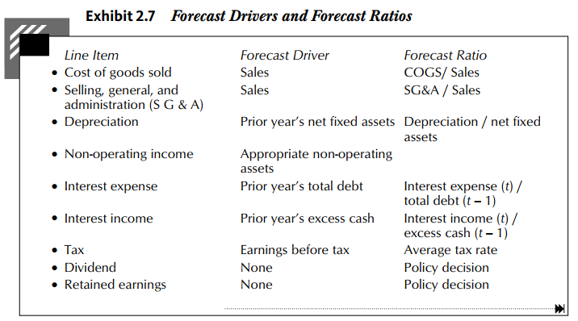
Forecast Drivers and Forecast Ratios (Book PC)

Slide 26
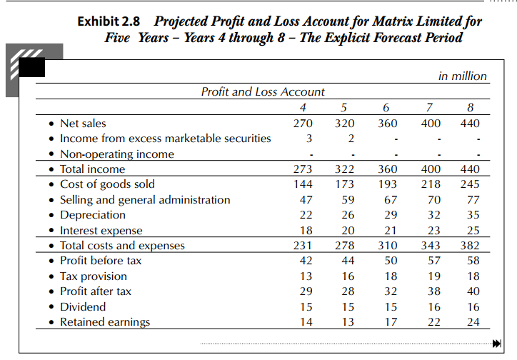
Forecasted P&L for Matrix Ltd. (Assume it is given)

Slide 27
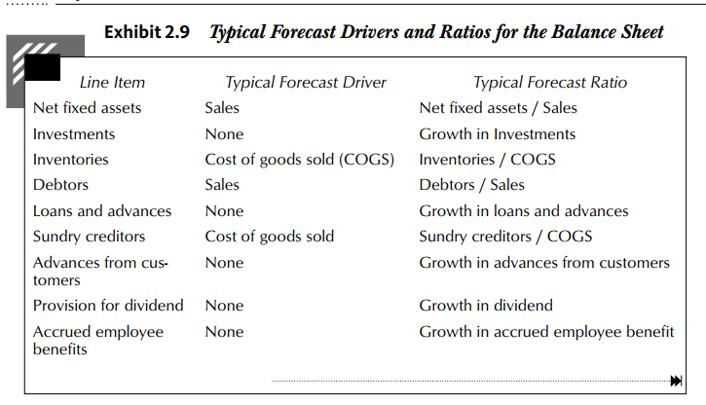
3. Forecast Balance Sheet both sides

Slide 28
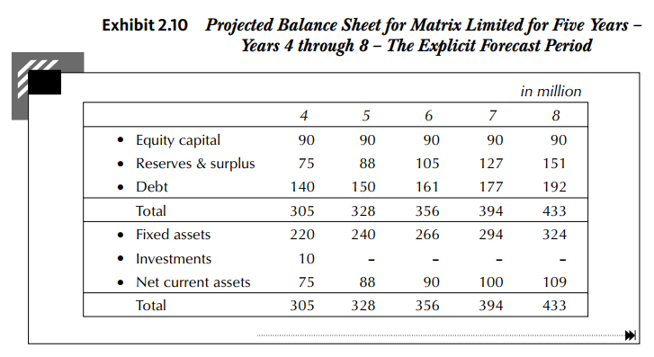
Forecasted BS for Matrix Ltd. (Assume it is given)

Slide 29
Explain
Assume all data in P&L is given after some projections, historical ratios, and adjustments (PC book does not mention that). Take it as face value (Assume a consultant has given these numbers).
In balance sheet, paid up capital is unchanged as mentioned by author.
Explain the relation of retained earnings and reserves and surplus.
Investments are liquidated (15 at the end of 4th and 10 at the end of 5th year, that is 1st and 2nd years of forecast horizon).
Calculate NOPLAT, ROIC, and FCFF for each forecasted year. (Refer to Excel)

Slide 30
6. Check for Consistency and Alignment
Evaluate the forecast for consistency and alignment by asking the following questions:
• Is the projected revenue growth consistent with industry growth?
• Is the ROIC justified by the industry’s competitive structure?
• What will be the impact of technological changes on risk and returns?
• Is the company capable of managing the proposed investments?
• Will the company be in a position to raise capital for its expansion needs?
Historically:
• It is very difficult for a company to outperform its peers for an extended period of time because competition often catches up, sooner or later.
• Industry average ROICs and growth rates are related to economic fundamentals.

Slide 31
Estimating Continuing/Terminal Value (CV/TV)
A variety of methods are available for estimating the continuing value. They may be classified into two broad categories: cash flow methods and non-cash flow methods.
Cash flow method is based on assumption of perpetual growth.
$${Continuing Value}_{t}=\frac{{Free Cash Flow}_{t+1}}{WACC−growth}$$
Where WACC is the weighted average cost of capital, and growth is the expected growth rate of free cash flow forever.
Example, Given: Free Cash Flow at the end of 10-year explicit forecast period is expected to be INR 10 Crores, WACC is 15%, growth in FCF is 7%. Compute Terminal/Continuing value.
Solution: (10X1.07)/(0.15-0.07); 133.75 at the end of 10th year; Hence, PV Today is INR 33.06 Crores (133.75/1.15^10)

Slide 32
Considerations in Estimating the CV Parameters
Free Cash flows: must be based on a normalized level of revenues and a margin (business cycles should be considered).
WACC: The weighted average cost of capital must reflect the underlying business risk and a sustainable capital structure.
Growth Rate: Very few companies can grow at a rate faster than the economy for prolonged periods.
Perhaps the best estimate for growth rate would be the real long-term growth rate for the industry plus inflation.
The historical growth rates (of Sales, margins, EPS, Cash flows) or expert estimated growth rates can be used in computation.
Growth could be because of: 1. Efficiency, and 2. Re-investment
The growth can also be computed as growth = reinvestment rate X return on investments. For example, if the reinvestment rate is 60 percent and the return on new investments is 15 percent, growth on account of new investments will be 9 percent (0.6 × 15). Growth rate is very sensitive to parameters, hence stable growth rate should be used (the nominal risk-free rate is a good proxy for the nominal growth rate in the economy).

Slide 33
Sensitivity of CV to the Formula’s Parameters
For example, Free Cash Flow at the end of 10-year explicit forecast period is expected to be INR 10 Crores, WACC is 15%, growth in FCF is 7%. Compute Terminal/Continuing value. (Take WACC 11-15%, Growth=5-9%)
The continuing value ranges enormously after slight change in WACC, g, or both.
Growth (when WACC=15%) | PV Today |  | WACC (when g=7%) | PV Today
5% | 25.95 |  | 11% | 94.21
6% | 29.11 |  | 12% | 68.9
7% | 33.06 |  | 13% | 52.53
8% | 38.14 |  | 14% | 41.23
9% | 44.91 |  | 15% | 33.06

Slide 34
Non-cash flow methods: Multiples Method
The multiples method assumes that the company will be worth some multiple of future earnings or book value or revenues during the continuing period. The commonly used multiples are enterprise value-to-EBITDA ratio, enterprise value-to book value ratio, and enterprise value-to-sales ratio.
For example, in EV/EBITDA multiple, the expected EBITDA of first year after the explicit forecast period is multiplied by a suitable EV/EBITDA ratio. This ratio is most popular, intuitive, and easy to implement. Similarly, EV/BV and EV/Sales can be applied.
The problem with these multiples is that these numbers are accounting numbers (not cash flows), hence subject to window dressing (manipulation). However, other ratios such as EV/cash flow can be used to avoid such things.

Slide 35
Non-cash flow methods: Replacement Cost Method
According to this method, the continuing value is equated with the expected replacement cost of the assets of the company.
The major limitation is that how to find replacement cost of intangibles (reputation of the company; brand image; relationships with suppliers, distributors, and customers; technical know-how; and so on).
Sometimes, the replacement costs are very high. In such cases, their replacement cost exceeds their value to the business as a going concern.

Slide 36
Non-cash flow methods: Liquidation Value Method
CV is equal to the proceeds expected from the sale of the assets of the firm at the end of explicit forecast period.
The liquidation value of a profitable, growing company is much less than its going concern value.
The liquidation value of a dying company may be greater than its going concern value.
Do not use the liquidation value method unless you expect the company to be liquidated at the end of the explicit forecast period.

Slide 37
CV of Matrix Limited example: CF method
$${Continuing Value}_{8}=\frac{{Free Cash Flow}_{9}}{WACC−growth}$$
Given: WACC=14%, Growth=10%, FCF at end of 8th year=16 (computed in excel); FCF at end of 9th year=16*1.10=17.6
So, CV at the end of 8th year = 17.6/(0.14-0.10) = 440 Million
PV of CV Today = 440/(1.14^5) = 228.52 Million
(Here the CV has been further discounted by 1.14^5. The explicit forecasting period is 5 years)

Slide 38
Final steps in valuation
After developing financial projections and continuing value estimate, we can move on to the final stage of the valuation exercise. This stage involves the following steps:
• Determine the value of operations
• Calculate the enterprise value and equity value
• Explore multiple scenarios
• Verify valuation results

Slide 39
Determine the value of operations
Discounted free cash flows for the explicit forecast period.
Use constant WACC for discounting the FCF.
If WACC changes over time, you may use a time-varying discount rate to discount future free cash flows (only if significant changes are expected in the capital structure of the firm or the cost of debt or tax rate).
Discount the Continuing Value:
CV is computed using perpetual growth model at the end of the explicit forecast period.
Hence, discount it for the number of years in the explicit forecast period.
Compute the Value of Operations: In the final step, add the present value of free cash flows in the explicit forecast period to the present value of continuing value to get the value of operations.

Slide 40
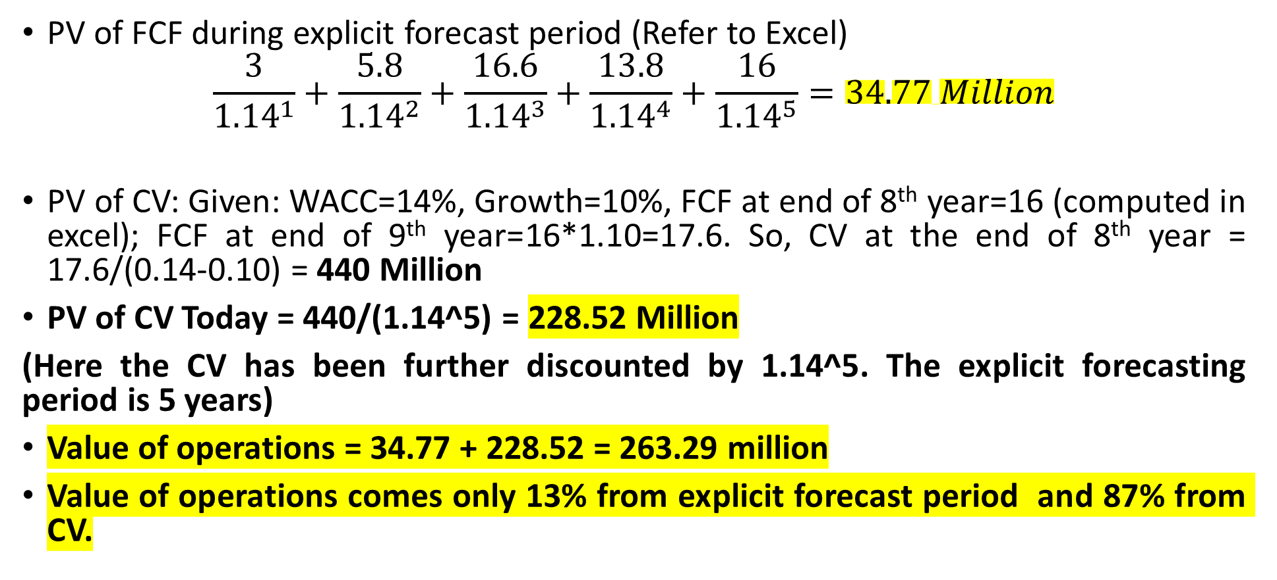
Value of operations for Matrix Ltd example
PV of FCF during explicit forecast period (Refer to Excel)
$$\frac{3}{{1.14}^{1}}+\frac{5.8}{{1.14}^{2}}+\frac{16.6}{{1.14}^{3}}+\frac{13.8}{{1.14}^{4}}+\frac{16}{{1.14}^{5}}=34.77 Million$$
PV of CV: Given: WACC=14%, Growth=10%, FCF at end of 8th year=16 (computed in excel); FCF at end of 9th year=16*1.10=17.6. So, CV at the end of 8th year = 17.6/(0.14-0.10) = 440 Million
PV of CV Today = 440/(1.14^5) = 228.52 Million
(Here the CV has been further discounted by 1.14^5. The explicit forecasting period is 5 years)
Value of operations = 34.77 + 228.52 = 263.29 million
Value of operations comes only 13% from explicit forecast period and 87% from CV.

Slide 41
Computation of Enterprise Value and Value of Equity
Enterprise value = Value of operations + Value of non-operating Assets
Equity value = Enterprise value – Value of non-equity claims
The best approach for determining the value of non-operating assets and non-equity claims depends on how their value changes with the DCF value of operations.
Cash flows relating to non-operating assets like excess cash and marketable securities are not included in the free cash flows and therefore not reflected in the value of operations. So, the value of non-operating assets must be added to the value of operations. Some examples and valuation is as follows:
Excess Cash and Marketable Securities: At market price
Quoted Investments in Associate Companies: At market price
Quoted Investments in Subsidiary Companies: At market price + some controlling premium
Unquoted Investments in Subsidiary Companies: Not listed. Hence, DCF or relative valuation
Excess Real Estate and Unutilized Assets: It is difficult to identify these assets. If you have information on these assets, rely on the most recent appraisal value.

Slide 42
Non-equity Claims
Equity value = Enterprise value – Value of non-equity claims
Non-equity claims represent all financial claims other than those of current equity shareholders. They may be classified as follows:
Debt: Market value if traded. If not traded, compute PV of all future payments (interest and principal) at current rate of interest.
Preference capital: Same as unsecured debt as mentioned. Discounted at the cost of unsecured debt.
Hybrid claims: Convertible debentures and convertible preference shares. These holders have an option to convert debt/PS in equity shares at a predetermined conversion ratio. In essence, a convertible debenture is a package of a straight debenture plus a call option (right to buy) on equity. The value of such options depends on the valuation of firm. If these are traded, use market value, otherwise use option-based valuation.
Employee stock options: If the cost of employee stock options is not fully reflected in free cash flow projections, the unreflected portion has to be valued and treated as a non-equity claim. It can be ignored all costs of ESOPs are reflected in Cash flow projections.

Slide 43
Enterprise Value and Equity Value of Matrix Limited
Assuming that the value of investments (the only non-operating assets) is 25 million (the balance sheet value) and the value on non-equity claims is 134 million (the balance sheet value), the enterprise value and equity value of Matrix Limited is:
Enterprise value = Value of operations + Value of non-operating Assets
=263.29+25 = 288.29 Million
Equity value = Enterprise value – Value of non-equity claims
=288.29-134 = 154.29 Million

Slide 44
Value under Multiple Scenarios
Valuation is done for strategic initiatives such as acquisition or divestments.
Uncertainty and risk is inherent in all business decisions, an analyst must think of scenarios and ranges of value, reflective of this uncertainty.
While assuming scenarios use top-down approach and critically examine your assumptions with respect to the following: broad economic conditions, competitive structure of the industry, internal capabilities of the company, and financing capabilities of the company.
Interpreting multiple scenarios is far more complex.
Every assumption and scenario should be documented and analyzed properly before reaching any conclusion.

Slide 45
Verify the valuation numbers
All financial forecasts of income statement and balance sheet are logical?
Balance sheet is matching/balancing every year?
If the expected ROIC is greater than the WACC, the value of operations must be greater than the book value of invested capital.
When you apply a continuing value formula the company achieves a steady state. If the company is still evolving, extend the explicit forecast period.
If the company is listed, compare your value estimate with the market value. If the market value is very different from your estimate, it makes sense to assume that the market is right, unless you have reason to believe that all relevant information is not incorporated in the market price due to factors such as small float or poor liquidity in the stock.
Compare the multiples of the company with its peers. Satisfy yourself that significant differences with peer companies can be explained in terms of value drivers and other relevant factors like business characteristics and strategy.

Slide 46
Practice
Solved Problem 2.1
Solved Problem 2.2
Appendix 2.C (Page 2.56)
Solved problem 1 (Page 2.61)

Slide 47
Computation of FCFF using Screener (Experiential Learning)
Dr. Sarveshwar Kumar Inani
(Ph.D., IIM Lucknow)

Slide 48
Using Live Data (Screener.in )
Learn by doing (Experiential Learning)
Download data for P&L and Cash flow statement from Screener.in for (Hindustan Unilever Limited)
Compute NOPLAT (EBIT and Adjusted taxes)
Compute FCFF
Practice FCFF for DMART
Source: YT Video

